Slide 1
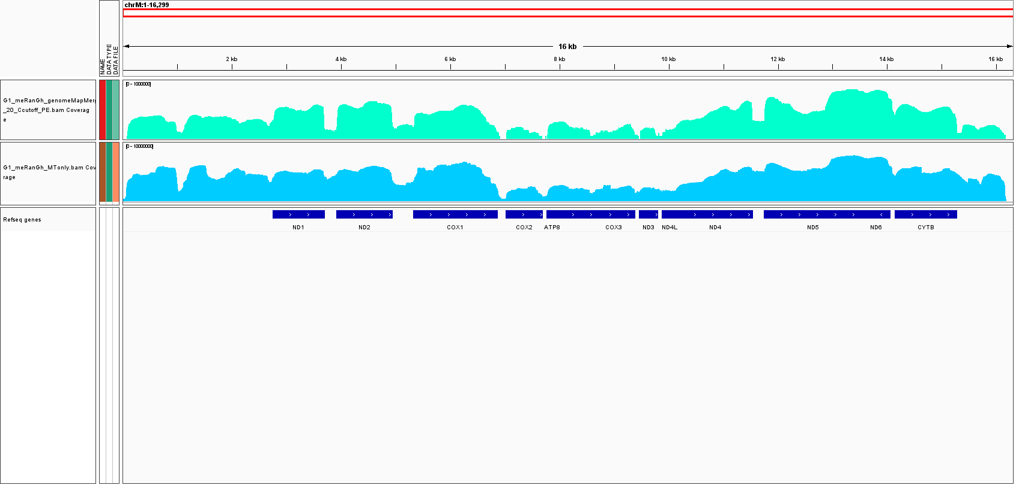
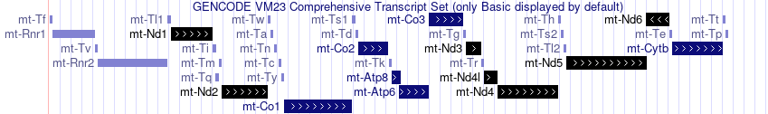
chrM
MT-A reads with < 20C
MT-A reads with ≥ 20C
[0-1e8]
[0-1e7]
Supplementary Figure 10. Read pile-up of MT-A along the mitochondrial chromosome. Reads containing fewer than p-m⁵C sites are displayed in cyan, while reads containing 20 or more p-m⁵C sites are displayed in teal. GENCODE gene annotations are displayed below.

